Slide 1

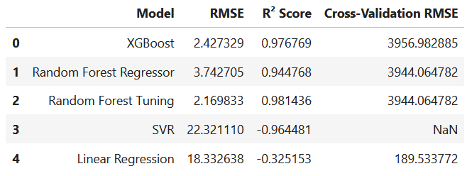
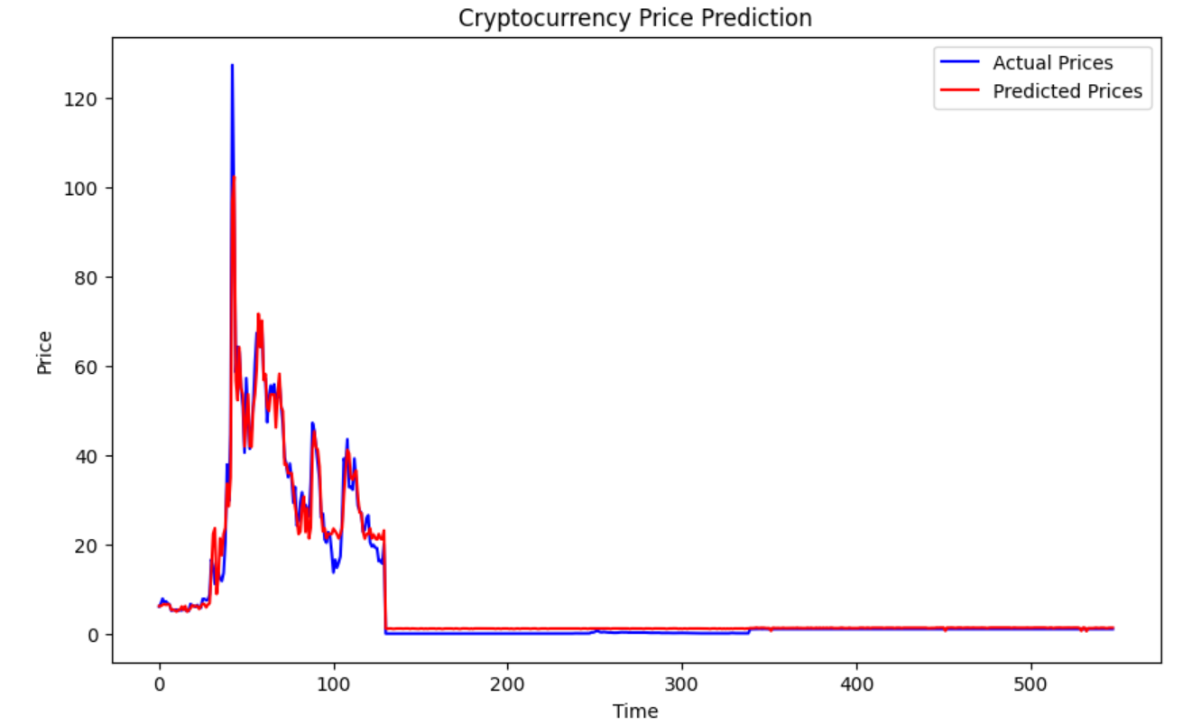
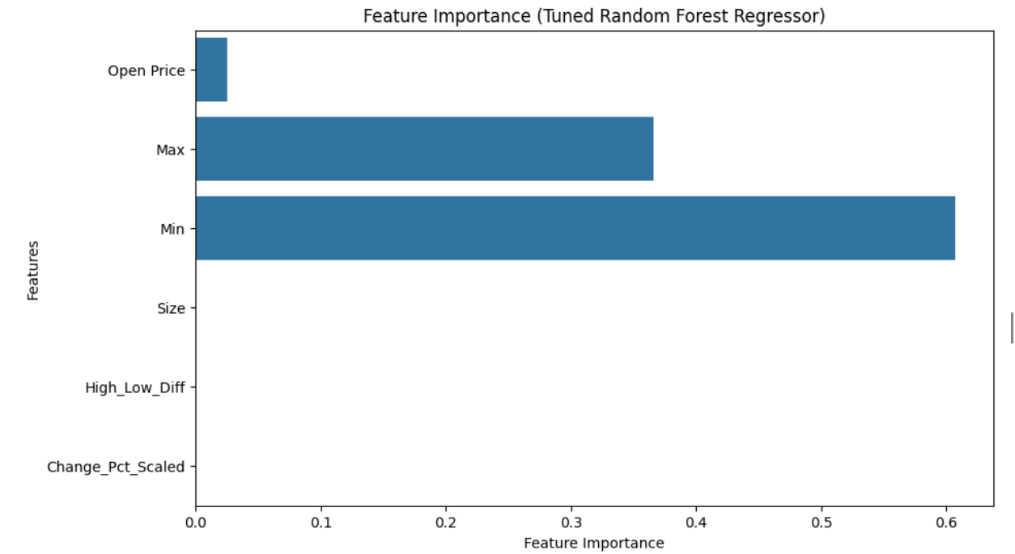
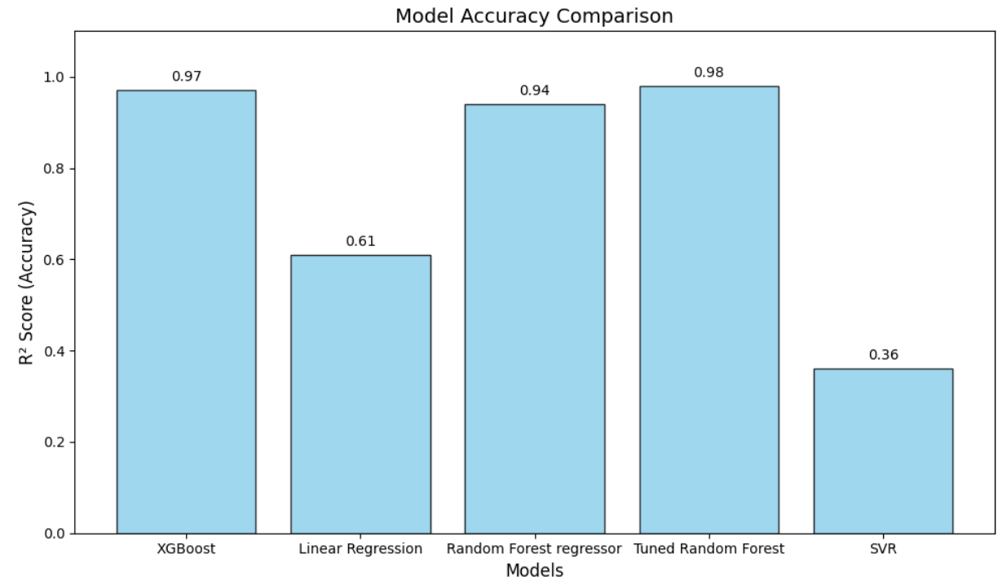
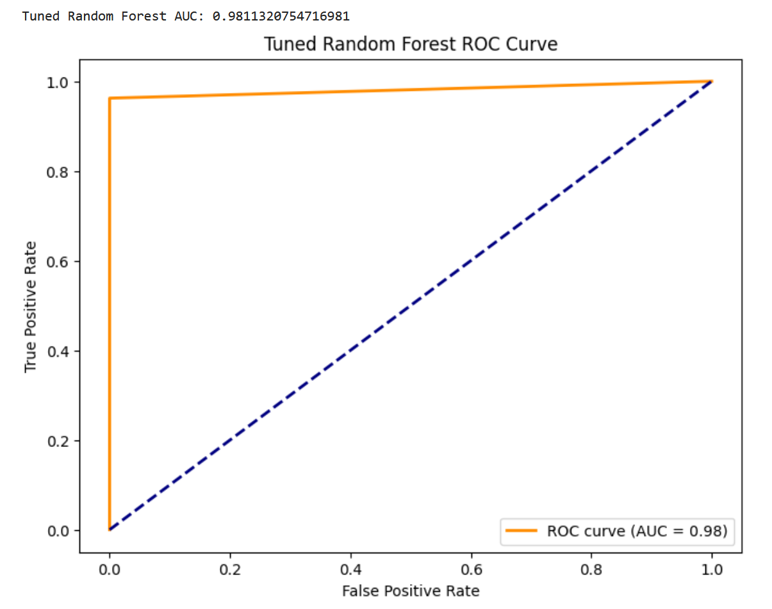
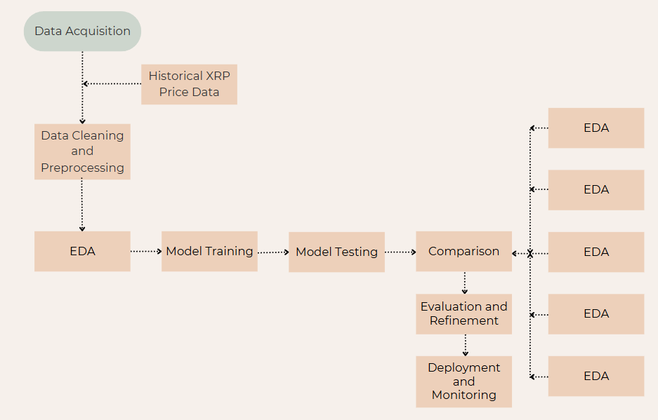
The project begins by collecting historical XRP market data, including open, high, low, last price, volume, and change percent. Preprocessing steps involve handling missing values (forward fill and mean imputation), detecting outliers, and performing feature engineering to create variables like High_Low_Diff and Change_Pct_Scaled. The data is then standardized using StandardScaler to ensure model efficiency. The dataset is split into training and testing sets using a time-series split to preserve the order of the data.
The project begins by collecting historical XRP market data, including open, high, low, last price, volume, and change percent. Preprocessing steps involve handling missing values (forward fill and mean imputation), detecting outliers, and performing feature engineering to create variables like High_Low_Diff and Change_Pct_Scaled. The data is then standardized using StandardScaler to ensure model efficiency. The dataset is split into training and testing sets using a time-series split to preserve the order of the data.
he project begins by collecting historical XRP market data, including open, high, low, last price, volume, and change percent. Preprocessing steps involve handling missing values (forward fill and mean imputation), detecting outliers, and performing feature engineering to create variables like High_Low_Diff and Change_Pct_Scaled. The data is then standardized using StandardScaler to ensure model efficiency. The dataset is split into training and testing sets using a time-series split to preserve the order of the data.
XRP CRYPTOCURRENCY RETURN PREDICTION
he project begins by collecting historical XRP market data, including open, high, low, last price, volume, and change percent. Preprocessing steps involve handling missing values (forward fill and mean imputation), detecting outliers, and performing feature engineering to create variables like High_Low_Diff and Change_Pct_Scaled. The data is then standardized using StandardScaler to ensure model efficiency. The dataset is split into training and testing sets using a time-series split to preserve the order of the data.
Pranavi Ravi , Namineni Sai Loukya | Ramanathan Lakshmanan | School of Computer Science and Engineering
Introduction
Results
XRP’s high volatility makes return prediction challenging. This study uses ML models—XGBoost, Random Forest, SVR, and Linear Regression—to predict XRP returns, with XGBoost and Random Forest showing the best performance .While past studies used models like LSTM and GRU, they often lacked key factors, faced overfitting, and used limited data. This study addresses these gaps with a more robust and optimized approach.
After training and evaluating all models, the results clearly demonstrated that ensemble learning methods outperformed traditional regression techniques. The Tuned Random Forest Regressor achieved the highest performance, with an R² score of 0.98 and low RMSE, indicating an excellent fit and strong predictive power. The XGBoost Regressor followed closely with an R² score of 0.97, making it another highly reliable model for forecasting XRP returns. These models were particularly effective due to their ability to capture non- linear patterns and handle noisy financial data. In contrast, Linear Regression and Support Vector Regression (SVR) models showed comparatively lower performance, with R² scores below 0.90. This is likely due to their limited ability to adapt to the volatility and complex structure inherent in cryptocurrency price movements. Hyperparameter tuning and feature engineering significantly enhanced the performance of all models, especially the ensemble-based ones.
A feature importance analysis was conducted using the trained Random Forest and XGBoost models. This analysis revealed that variables such as the high-low price difference, percentage change, and trading volume had the greatest influence on return prediction. These findings validated our feature engineering choices and also aligned well with financial domain knowledge. The final predictions from the best- performing models closely matched actual XRP prices, as visualized in the “Actual vs Predicted” graphs. This demonstrated that the models not only fit the training data well but also generalized effectively to unseen test data, highlighting their robustness and real-world applicability in financial forecasting.
Motivation
The volatile nature of cryptocurrency markets, especially XRP, makes return prediction highly challenging yet crucial for informed investment decisions. Traditional models often fail to capture complex patterns and external influences. This motivated us to explore machine learning techniques that can offer more accurate, scalable, and data-driven predictions to support better financial decision-making in the crypto space.
Scope of the Project
This project aims to predict XRP cryptocurrency returns using machine learning techniques. It involves collecting and preprocessing historical price data, training models such as XGBoost, Random Forest, SVR, and Linear Regression, and evaluating their performance. The goal is to identify key factors influencing XRP trends and develop a reliable prediction system to assist traders and investors in making informed decisions in a highly volatile market.
Methodology
The project began with acquiring historical XRP data containing essential fields like Open, High, Low, Last Price, and Volume from a reliable financial source. Data reprocessing involved handling missing values using forward fill for time- dependent fields and mean imputation for numerical gaps, ensuring consistency. Feature engineering was applied to derive more informative attributes such as the High-Low Price Difference and Scaled Percentage Change, which helped capture market volatility and trends. StandardScaler was then used to normalize the data, enabling fair feature contribution across models, particularly important for SVR.
In the modelling phase, four algorithms were implemented: Linear Regression, SVR, Random Forest, and XGBoost. These ranged from basic linear models to advanced ensemble methods capable of identifying complex patterns. The dataset was split chronologically to preserve time-series integrity. To ensure model robustness and prevent overfitting, k-fold cross- validation was employed. Hyperparameter tuning via GridSearchCV and Randomized SearchCV optimized model performance—especially for ensemble models—by fine- tuning parameters for improved accuracy and stability.
Model evaluation was conducted using key regression metrics: Root Mean Squared Error (RMSE) and R² Score, which measure prediction error, and the proportion of variance explained, respectively. Feature importance was analyzed post-training to identify which input variables had the greatest influence on the model’s predictions. This step provided insights into market behavior and validated the relevance of the engineered features. Among all the models tested, Tuned Random Forest and XGBoost emerged as the best performers, achieving high R² values (up to 0.98), indicating excellent prediction capability. These models were then used to make predictions on unseen test data, demonstrating strong potential for real-world application in cryptocurrency return forecasting.
Conclusion
This project successfully demonstrated the use of machine learning models—particularly Tuned Random Forest and XGBoost—for predicting short-term XRP cryptocurrency returns with high accuracy (R² ≈ 0.97–0.98). The use of technical indicators, robust feature engineering, and hyperparameter tuning allowed these ensemble models to outperform traditional approaches. The results validate the potential of ML in capturing the non-linear dynamics of volatile financial markets and offer valuable tools for informed investment decision-making.
Future enhancements will involve using deep learning models like LSTM for better time-series forecasting and incorporating sentiment analysis from news and social media to capture market trends. Adding macroeconomic indicators and real-time data streams can further improve prediction accuracy. Lastly, implementing explainable AI techniques will enhance model transparency and trust for financial decision-making.
References
. Huang, J. Z., Huang, W., & Ni, J. (2019). Predicting bitcoin returns using high-dimensional technical indicators. The Journal of Finance and Data Science, 5(3), 140-155.
Ahmad, T., & Abbas, M. (2024). AI Based Cryptocurrency Price Prediction: A Comparative Analysis of Traditional & Deep Learning Models with Sentiment Integration (Master's thesis, UIS).
Khan, F. U., Khan, F., & Shaikh, P. A. (2023). Forecasting returns volatility of cryptocurrency by applying various deep learning algorithms. Future Business Journal, 9(1), 25.

